Slide 1
IOT SMART OFFICE SIMULATION
PRESENTED BY
Adusuru Harsha Vardhan[192524212]
Dhanshika[192511139]
Arshiya[192511137]

Slide 2
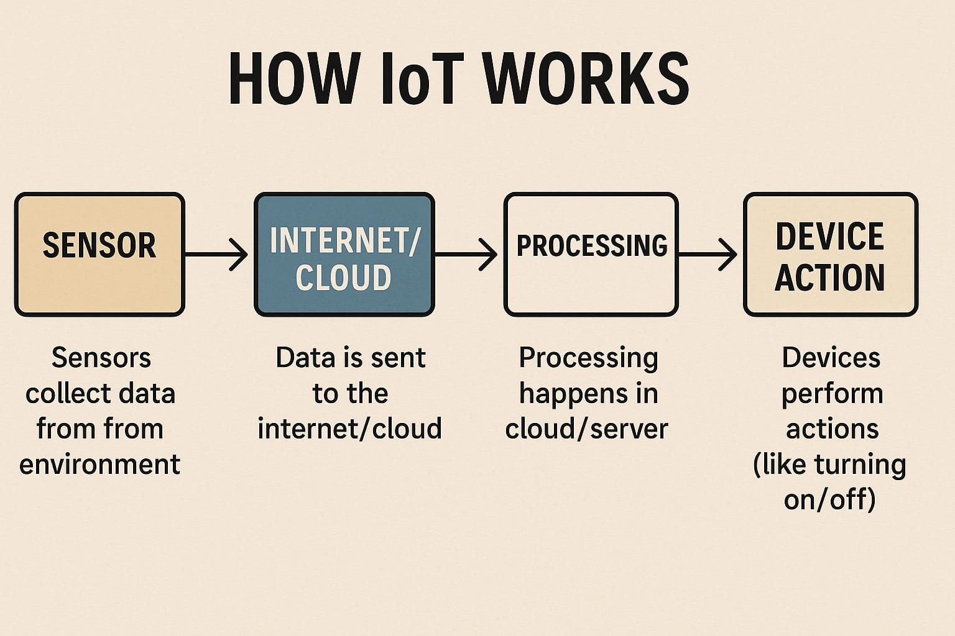
IOT INTERNET OF THINGS
IOT means Physical devices which is connected to the internet

Slide 3
Here are the key points of IoT Smart Office Simulation: • 🌐 Connects smart devices using internet. • 🧠 Automates office tasks (lighting, AC, access). • 🖥️ Uses simulation tools (like Cisco Packet Tracer). • 📊 Improves energy efficiency and productivity. • 🔒 Includes smart security (e.g., ID card, sensors). • 📡 Allows remote monitoring and control. • 🛠️ Tests system performance before real setup.

Slide 4
Module titleS
ACCESS CONTROL AND SECURITY MODULE
It will allows only authourized people access
1.Physical Access Control – Like smart locks, ID card access, fingerprint readers.
2. Logical Access Control – Like usernames, passwords, or admin vs. guest roles in software.

Slide 5
SMART LIGHTING AUTOMATION MODULE
It control lights automatically based on presence, time, or daylight.
Introduction:
• IoT-based system to automate lighting based on motion, ambient light, or time
. • Ensures energy efficiency, convenience, and smart control via mobile or sensors.
• Ideal for homes, offices, classrooms, etc.

Slide 6
Working Principle:
• When motion is detected and ambient light is low → Light turns ON.
• If no motion is detected for a set time → Light turns OFF.
• User can override manually via mobile app.
• All data and control via Wi-Fi.⸻
Advantages:
• Saves electricity by avoiding unwanted usage
• Improves user comfort and safety
• Touchless operation – ideal for hygiene-sensitive areas
• Smart integration with other IoT systems

Slide 7
Room automatic system using IOT
It detects the motion, measures , temperature, and controls lights/fans automatically
Auto light ON/OFF when someone enters/leaves.
AC turns on if room exceeds 28°C.
Curtains close automatically in the evening.
Devices can be controlled using a smartphone from anywhere.

Slide 8
Advantages:
• Saves electricity automatically
• Touch-free appliance control
• User-friendly and secure
• Can be extended to smart
Applications:
• Smart Homes
• Offices
• Hostels/PGs
• Conference Rooms
• Hospitals

Slide 9
COMPONENTS
PIR sensor~ It will detects the motion of the humans
LDR sensor~ It will detects the light{Bright light~Low resistance, Darkness~High resistance}
RFID sensor~It will increases security and keeps attendance records

Slide 10
Conclusion / Outcome of IoT Smart Office Simulation
• Successfully automates and controls office devices (like lights, fans, doors) using IoT.
• Demonstrates energy saving, security, and smart environment management.
• Shows how sensors (LDR, motion, temperature) and controllers (Arduino, ESP8266) work together.
• Provides a real-time simulation of a smart office using tools like Cisco Packet Tracer, Proteus, or Blynk app.
• Helps understand how IoT improves efficiency, safety, and convenience in modern workplaces.

Slide 11
Thank you!!

